Slide 1
Intel 8086 architecture and addressing modes
CHAPTER 3

Slide 2
Major features of 8086 processor
8086 Microprocessor is an enhanced version of 8085 Microprocessor that was designed by Intel in 1976.
It is a 16-bit Microprocessor having 20 address lines and16 data lines that provides up to 1MB storage.
It consists of powerful instruction set, which provides operations like multiplication and division easily.
It supports two modes of operation, i.e. Maximum mode and Minimum mode.
Maximum mode is suitable for system having multiple processors and Minimum mode is suitable for system having a single processor.

Slide 3
Features of 8086
The most prominent features of a 8086 microprocessor are as follows −
It has an instruction queue, which is capable of storing six instruction bytes from the memory resulting in faster processing.
It was the first 16-bit processor having 16-bit ALU, 16-bit registers, internal data bus, and 16-bit external data bus resulting in faster processing.
It is available in 3 versions based on the frequency of operation −
8086 → 5MHz
8086-2 → 8MHz
8086-1 → 10 MHz

Slide 4
It uses two stages of pipelining, i.e. Fetch Stage and Execute Stage, which improves performance.
Fetch stage can pre-fetch up to 6 bytes of instructions and stores them in the queue.
Execute stage executes these instructions.
It has 256 vectored interrupts.
It consists of 29,000 transistors.

Slide 5
8085 Microprocessor | 8086 Microprocessor
It is an 8-bit microprocessor. | It is a 16-bit microprocessor.
It has a 16-bit address line. | It has a 20-bit address line.
It has a 8-bit data bus. | It has a 16-bit data bus.
The memory capacity is 64 KB. | The memory capacity is 1 MB.
The Clock speed of this microprocessor is 3 MHz. | The Clock speed of this microprocessor varies between 5, 8 and 10 MHz for different versions.
It has five flags. | It has nine flags.
8085 microprocessor does not support memory segmentation. | 8086 microprocessor supports memory segmentation.
It does not support pipelining. | It supports pipelining.
It is accumulator based processor. | It is general purpose register based processor.
It has no minimum or maximum mode. | It has minimum and maximum modes.
In 8085, only one processor is used. | In 8086, more than one processor is used. An additional external processor can also be employed.
It contains less number of transistors compare to 8086 microprocessor. It contains about 6500 transistor. | It contains more number of transistors compare to 8085 microprocessor. It contains about 29000 transistors.
The cost of 8085 is low. | The cost of 8086 is high.

Slide 6
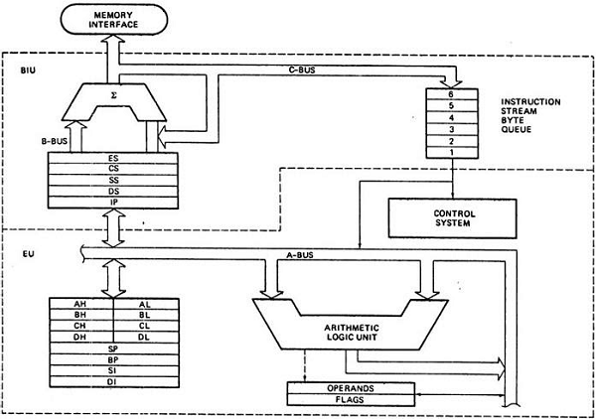
Architecture of 8086

Slide 7
8086 Microprocessor is divided into two functional units:
EU (Execution Unit):
Execution unit gives instructions to BIU stating from where to fetch the data and then decode and execute those instructions.
Its function is to control operations on data using the instruction decoder & ALU.
EU has no direct connection with system buses as shown in the previous figure, it performs operations over data through BIU.
EU consists of the following components:
ALU
Flag registers.

Slide 8
1. ALU:
It handles all arithmetic and logical operations, like +, −, ×, /, OR, AND, NOT operations.
2. Flag Register:
It is a 16-bit register that behaves like a flip-flop, i.e. it changes its status according to the result stored in the accumulator.
It has 9 flags and they are divided into 2 groups
2.1 Conditional Flags
2.2 Control Flags.

Slide 9
2.1. Conditional Flags
It represents the result of the last arithmetic or logical instruction executed. Following is the list of conditional flags −
Carry flag
This flag indicates an overflow condition for arithmetic operations.
Auxiliary flag
When an operation is performed at ALU, if it results in a carry/barrow from lower nibble (i.e. D0 – D3) to upper nibble (i.e. D4 – D7), then this flag is set, i.e. carry given by D3 bit to D4 is AF flag.
Parity flag −
This flag is used to indicate the parity of the result, i.e. when the lower order 8-bits of the result contains even number of 1’s, then the Parity Flag is set.
For odd number of 1’s, the Parity Flag is reset.

Slide 10
Zero flag
This flag is set to 1 when the result of arithmetic or logical operation is zero else it is set to 0.
Sign flag
This flag holds the sign of the result.
When the result of the operation is negative, then the sign flag is set to 1 else set to 0.
Overflow flag
This flag represents the result when the system capacity is exceeded.

